Slide 1
Machine learning to drive straight
Ethan Hansen, Laura Denney, Carly Thorkildson

Slide 2
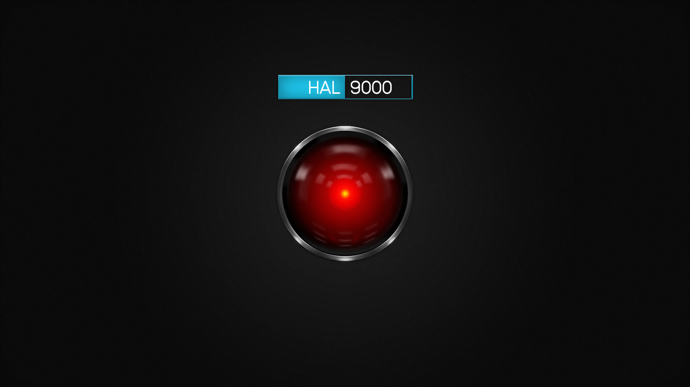
What is Machine Learning?
Don’t give exact algorithm
Give learning algorithm training data
Find close to the optimal configuration
Unsupervised vs. Supervised
Reinforcement
Genetic algorithm

Slide 3
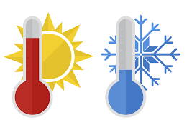
Level 1 - Hot and cold
Like game hot and cold
Robot drives
Tell it “hotter” or “colder”
Robot learns from that
Repeat

Slide 4
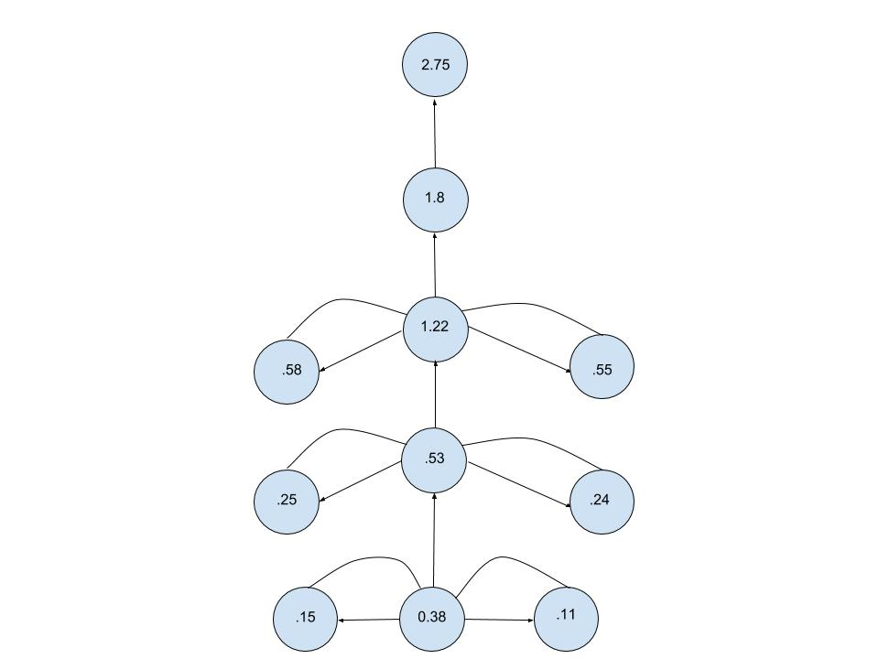
Level 2 - Branches of a path
Branches of a path
100 choices at each junction
Picks one
Maybe better, maybe worse

Slide 5
Level 3 - Pseudocode
Set random motor controller variables
Drive for 5 seconds with the new variables
Get new distance from trainer
Create new variables from last best variables
Loop

Slide 6
Level 4 - Better pseudocode
Set original random motor controller variable (10 - 110) and reset distances
Reset timer and user input
Drive for 5 seconds with the new MC variables
Wait for the trainer to enter a distance and the go ahead number (1)
If the new distance was better than the old distance, random pick new MC variables around the last used MC variables
If the old distance was better than the new distance, random pick new MC variables around the old MC variables

Slide 7
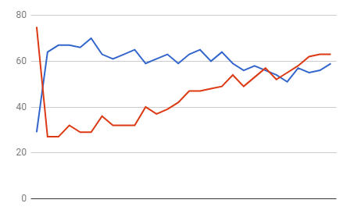
Graph of MC variables

Slide 8
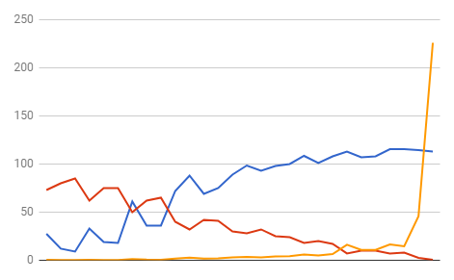
Graph of distance, angle, and calculated distance

